Slide 1
About Machine Learning
What is ML
Machine learning (ML) is defined as a discipline of artificial intelligence (AI) that provides machines the ability to automatically learn from data and past experiences to identify patterns and make predictions.
How does ML work
Machine learning algorithms are molded on a training dataset to create a model. As new input data is introduced to the trained ML algorithm, it uses the developed model to make a prediction.

Slide 2

ML Model build step
①Training data
⑥Successful model
②Train ML algorithm
⑤Prediction accuracy monitor
New input data
③Validation Data
④Prediction

Slide 3
Model Performance tracking example 1
Data Preparation
Accuracy monitoring
96.91%
81.4%
The model confidence level set is 90%. Average in pass class is 81.4%
Average accuracy 99.91%

Slide 4
Model Performance tracking example 2
Rakuten Accuracy monitoring
38.9%
99.89%
The model confidence level set is 95%. Average in pass class is 38.9%
Average accuracy 99.89%

Slide 5
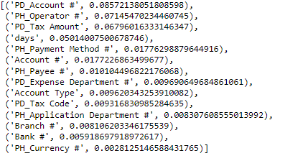
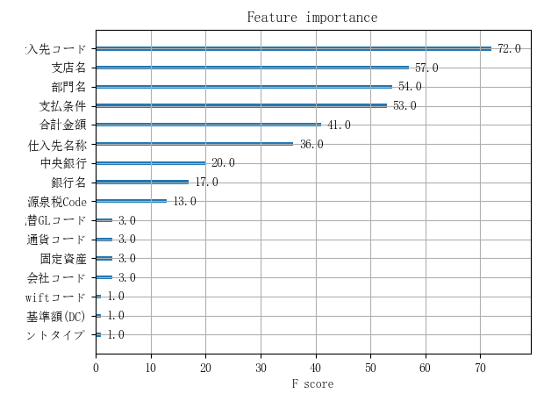
Model predict key feature example
Data Preparation

